Slide 1
While Loop

Slide 2
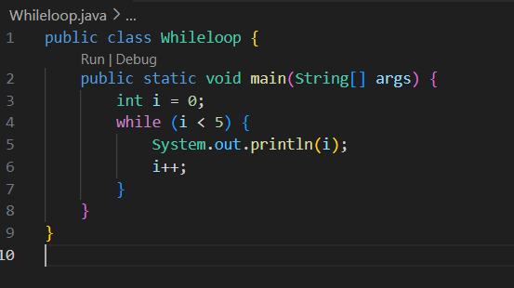
Java

Slide 3
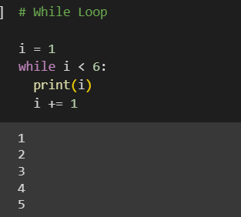
Python

Slide 4
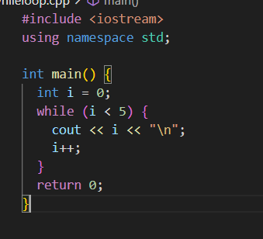
C++

Slide 5
Major difference between for loop and the while loop
For loop is used when the number of iterations is known, whereas execution is done
In the while loop until the statement in the program is proved wrong.

Slide 6
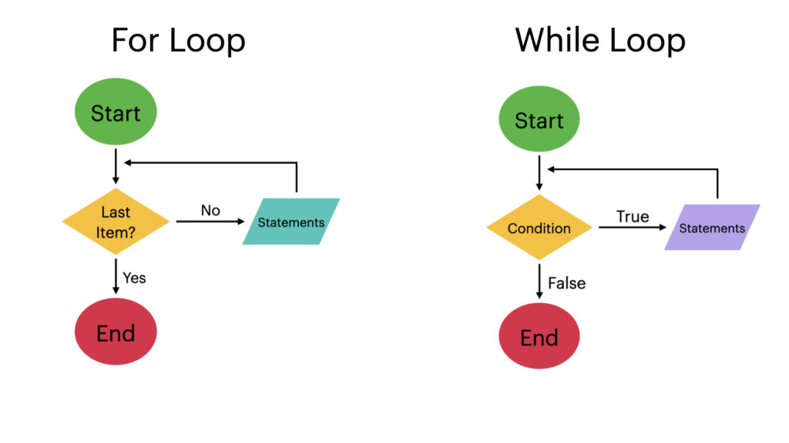
While vs For Loop

Slide 7
Tasks…..
• Write a program to print the multiplication table of a given number.
• Write a program to print the even numbers between 1 and 50.
• Write a program to find the sum of all elements in an array of integers.
• Write a program to find the largest and smallest elements in an array of integers.
• Write a program to find the factorial of a given number.

